Slide 1

Proposed S&I Framework / HL7 Pilot Study for CLIM informed by FHIM and HL7 CIMI & DCMs
Common Logical Information Model (CLIM) @ HL7
Informed by FHIM and HL7 CIMI and DCMS
Using MDHT-MDMI to create Implementation Guides for
Clear, Complete, Concise, Correct and Consistent
FHIR, CDA, NIEM and XML Messages
among the Federal Partners
Period of Performance: Jan-Sep 2016
Topic Area: Immunization Management or Transfer of Care
By
Steve Wagner, FHIM Project Manager
Steve Hufnagel, FHIM HL7 Facilitator
Notes:
Add FHIM enablers & partnerships blank title slide

Slide 2
Current S&I Approach to US Health IT Reference Architecture
Engage with SDOs
Finalize/Select Technical Solution from Pilots sent to SDO(s)
Create/Update/ Publish Standards or IG using SDO Processes & Resources (based of finalized pilot solution)
Create Problem Statement & Functional Requirements
Conduct Pilots
S&I Support Team + Pilot Community
2016 Pilot
S&I Support Team + Pilot Community + HL7
2017-2018 Draft Standard
for Trial Use (DSTU)
2019 HL7
Normative Ballot
12/20/2015
This is a working document; it is not approved for official use / public distribution.

Slide 3
Common Logical Information Model (CLIM) aka US Health IT Reference Architecture @ HL7
Common Logical Information Model (CLIM)
Informed by FHIM CIMI & DCMs
Linked to S&I Framework Use-Case Simplification
Tool based
Traceability to
Laws and Regulations
Jurisdictional Policies
DOD-VA IBRM, ISA, JIP
Clinical Guidelines
Clinical Pathways
Quality Measures
Implementations
Tests and Certifications
Linked to IBRM & EHR System Functional Model
Linked to
NIST Risk
and Security Framework
Linked to IHE Technical Framework
Linked to NIST HIT Standards and Testing
MDHT-MDMI
NIEM
FHIR
CDA/CCDA
XML Msg./API
Goal is consistent data formats and semantics across implementation paradigms IAW FHA 2015 Interoperability Roadmap
12/20/2015
This is a working document; it is not approved for official use / public distribution.
Notes:
This is an investigative 6-12 month pilot study
The goal is to demonstrate, to the FHA Federal Partners, the practical value of an HIT-CLIM, informed by Common Information Modelling Initiative (CIMI) architype models, HL7 Detailed Clinical Models (DCMs)& Clinical Statement Pattern UML models, and Federal Health Information Model (FHIM) UML models; where, appropriate Software Development Lifecycle (SDLC) traceability is maintained.
The scope is immunization management, defined by the AHIC/HITSP use case, CDC use case(s) and HL7 DAM for immunization management.
The approach is to
construct a CIMI conformant UML model (AML profile & CIMI reference Model)
use the Open Health Tools (OHT) Model Driven Health Tool (MDHT)/ Model Driven Message Interface (MDMI) to develop consistent V2 & NIEM message(s), CDA/CCDA and FHIR implementation guides (IG) / interoperability specifications (IS).
The products of the pilot study include:
Immunization Management HIT-CLIM, using AML UML and CIMI Reference Model.
MDHT/MDMI generated HL7 V2 & NIEM message, CDA and FHIR IG/IS
Traceability to
S&I Framework-Simplification Use-Case-Framework events and actions
IHE Technical Framework implementation profiles
EHR System Functional Model
NIST Security and Risk Framework
Assessment of CIMI, FHIM, DCMs and MDHT supporting a comprehensive HIT-CLIM
HL7 Project Scope Statement in Jun-Sep timeframe for a Comprehensive HIT-CLIM
Remediation recommendations, as required, for CIMI, FHIM, DCMs, MDHT
Work Breakdown Structure (WBS) for comprehensive HIT-CLIM
Integrated Master Schedule (IMS) for comprehensive HIT-CLIM
Risk and Risk mediation factors
Users Guide and demonstration for FHA Federal Partners
GO/NOGO Decision Brief for FHA Federal Partners

Slide 4
CLIM Talking Points
This is an investigative 6-12 month pilot study
The goal is to demonstrate, to the FHA Federal Partners, the practical value of an HIT-CLIM, informed by Common Information Modelling Initiative (CIMI) architype models, HL7 Detailed Clinical Models (DCMs)& Clinical Statement Pattern UML models, and Federal Health Information Model (FHIM) UML models; where, appropriate Software Development Lifecycle (SDLC) traceability is maintained.
The scope is immunization management, defined by the AHIC/HITSP use case, CDC use case(s) and HL7 DAM for immunization management.
The approach is to
construct a CIMI conformant UML model (AML profile & CIMI reference Model)
use the Open Health Tools (OHT) Model Driven Health Tool (MDHT)/ Model Driven Message Interface (MDMI) to develop consistent V2 & NIEM message(s), CDA/CCDA and FHIR implementation guides (IG) / interoperability specifications (IS).
The products of the pilot study include:
Immunization Management HIT-CLIM, using AML UML and CIMI Reference Model.
MDHT/MDMI generated HL7 V2 & NIEM message, CDA and FHIR IG/IS
Traceability to
S&I Framework-Simplification Use-Case-Framework events and actions
IHE Technical Framework implementation profiles
IBRM and EHR System Functional Model
NIST Security and Risk Framework
Assessment of CIMI, FHIM, DCMs and MDHT supporting a comprehensive HIT-CLIM
HL7 Project Scope Statement in Jun-Sep timeframe for a Comprehensive HIT-CLIM
Remediation recommendations, as required, for CIMI, FHIM, DCMs, MDHT
Work Breakdown Structure (WBS) for comprehensive HIT-CLIM
Integrated Master Schedule (IMS) for comprehensive HIT-CLIM
Risk and Risk mediation factors
Users Guide and demonstration for FHA Federal Partners
GO/NOGO Decision Brief for FHA Federal Partners
12/20/2015
See notes page for additional details
Notes:
HL7 Clinical Models and CIMI focus on concepts and the necessary meta-data / provenance (who, what, when, where, how) to support specific use cases.
FHIM focuses on domains and the context in which entities, associations and their attributes and value sets exist, based on the Federal Use Cases and SME input.
DAF can use FHIM as its information model to support federated queries.

Slide 5
Common Logical Information Model (CLIM) US HIT Ref. Arch. User-Story / Use Case
Clinician Lists prioritize Health Data Sharing (HDS) initiatives; where, the lists inform
Business Use Cases (UCs) developed by Analysts; and, the UCs inform / constrain
System Objects, Capabilities, Services, and Information Exchange Requirements (IERs) described by Analysts and Architects, who are informed by
IBRM and/or EHR-S System Functional Model
CLIM informed by FHIM, HL7 Detailed Clinical Models (DCMs) and CIMI models
System Physical Repositories are specified by Architects and Designers, based on
System Objects, Capabilities, and Services specified as EHR-S FM & FHIM subsets.
System Information Exchanges are specified by Architects & Designers, based on
MDHT-MDMI (FHIM) generated Implementation Guides (IGs)
for NIEM, FHIR, CDA/CCDA or HL7 V2, NCPDP, X12, etc.
FHIM-based queries/APIs to obtain required data from Physical Repositories.
NIST Security Framework and IHE Technical Framework to manage the exchanges.
NIST SP-800 Risk Assessment/Management Framework to manage network risk.
Implementation Guides are specified by Federal Partners using MDHT-MDMI
12/20/2015
See notes page for additional details
Notes:
HL7 Clinical Models and CIMI focus on concepts and the necessary meta-data / provenance (who, what, when, where, how) to support specific use cases.
FHIM focuses on domains and the context in which entities, associations and their attributes and value sets exist, based on the Federal Use Cases and SME input.
DAF can use FHIM as its information model to support federated queries.

Slide 6
Notional FHA Target Health IT Model-Driven Architecture (MDA)
Prioritized Lists
ISA
Business
Use Cases
FHIM, HL7 DCMs,
CIMI Architypes
IBRM & EHR System
Functions Model
Common Logical
Information Model
Bus iness ||| Technical
Behavior
Information
Information
Exchange Model
Physical
Repository Model
IHE Framework
HL7 (FHIR, CDA, CCDA, V2) and ASTM, DICOM, NCPDP, X-12, NIEM, etc..
NIST Risk-Security
Framework
12/20/2015
This is a working document; it is not approved for official use / public distribution.

Slide 7
Notional Software Development Lifecycle FHA Target MDA Users and Uses
Prioritized Lists
ISA
Business
Use Cases
FHIM, HL7 DCMs,
CIMI Architypes
Stakeholders
use to
inform
Clinical SMEs
use to inform/constrain
Analysts
create/use to identify functions
Analysts
create/use to identify data
Clinical SMEs
use to inform/constrain
inform
IBRM & EHR System
Functions Model
Common Logical
Information Model
Analysts and Architects
define system objects
and capabilities*
Analysts and Architects
constrain to specify workflow supported by
Analysts and Designers
constrain to specify data/value sets for
inform
inform
Information
Exchange Model
Physical
Repository Models
Architects & Designers
specify standard queries,
IHE & NIST Frameworks
Designers use MDHT - MDMI
to generate Implementation Guides
inform
inform
IHE Framework
HL7 (FHIR, CDA, CCDA, V2) and ASTM, DICOM, NCPDP, X-12, NIEM, etc..
Developers
implement interoperable exchanges
Testers
certify interoperable exchanges
NIST Risk-Security
Framework
12/20/2015
See notes page for additional details
Notes:
HL7 Clinical Models and CIMI focus on concepts and the necessary meta-data / provenance (who, what, when, where, how) to support specific use cases.
FHIM focuses on domains and the context in which entities, associations and their attributes and value sets exist, based on the Federal Use Cases and SME input.
DAF can use FHIM as its information model to support federated queries.

Slide 8
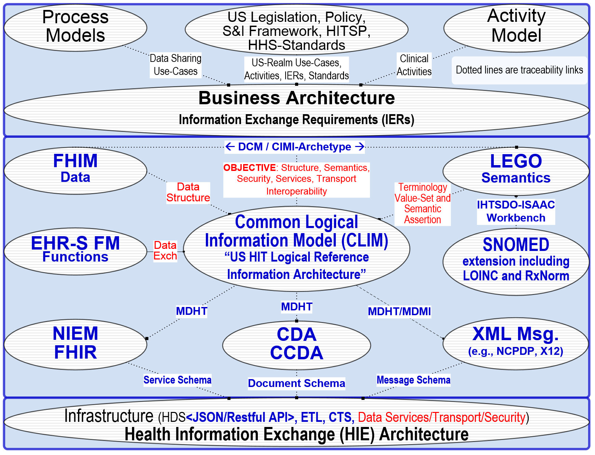
Common Logical Information Model (CLIM) US HIT MDA Informatics View
12/20/2015
This is a working document; it is not approved for official use / public distribution.

Slide 9
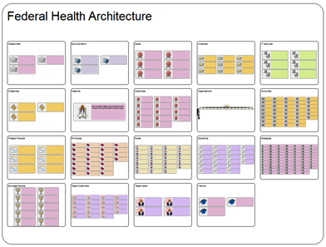
FHA 2025 Target Architecture
US Health IT
Reference Architecture
… fully integrated tool-based
Data Models
Business Models
Standards Profiles
Infrastructure Platforms
Technology Alternatives
Component / Service APIs
… faster, better, cheaper
Health Information Exchange
Strategic, Standards Based, Simple
Knowledge Driven, Reliable, Reusable
Accessible, Secure, Sustainable
Risk Management Framework Guided
Laws, Policies
Health IT Strategy
Health IT Roadmap
Many models, many artifacts
12/20/2015
See notes page for additional details
Notes:
Given FHIM is a part of Gail’s Target Architecture, we wanted to insert some of those bigger picture elements so the context of FHIM is better understood.
Current Questions Addressed by Proof of Concept
What are the dependencies between Federal Health strategies from multiple organizations?
What are the potential gaps and overlaps across the strategies?
What are the impacts to current time frames and strategies based on changes to achievements in milestones?
What strategies are supported by the Pilot Projects?
Potential Questions Strategic Architecture Could Address:
What are the key milestone dates that are impacted by other activities? (would require information regarding milestones and activities from each Federal Partner)
What percentage are we to being able to completing the achievement of a Critical Action, or Learning Health System Requirement (would require detailed milestones and statuses from all of the related partner actions tied to each critical action)
How do all of the partner activities relate back to each of the Objectives from the Federal Health IT Strategic Plan
What laws, regulations, and policies affect each of the Roadmap Critical Actions, Learning Health System Requirements, or FHIT Strat Plan Objectives? (requires information and linkages to laws, regulations, and policies)
What potentially duplicative healthcare functions exist across Federal Agencies (requires information regarding business functions and capabilities from across several Federal Agencies).
What does the IT spend across the Federal Government to address each Interoperability Roadmap Critical Action look like? (would require budget and investment information linked to all of the activities that support each Roadmap Critical Action)

Slide 10

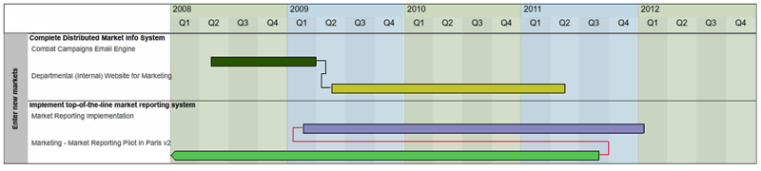
Strategic US Health IT Reference Architecture Implementations
Architecture
Tools / Database
Data-Driven Dashboard
12/20/2015
See notes page for additional details
Notes:
The architecture can be used as an analytical engine to support data-driven decision-making through an easy to interpret dashboard. The example shows how architecture can enable the execution of Strategy Implementation.

Slide 11
Proposed HL7 Schedule for US HIT Common Logical Information Model (CLIM)
January 2016 – HL7 CLIM Pilot Project Scope Statement
May/Jun 2016 – HL7 CLIM Pilot Demonstration to FHA Management
Comprehensive WBS, IMS, GO/NOGO Brief
Sept/Oct 2016 – HL7 CLIM Comprehensive Project Scope Statement
Sept/Oct 2017 – HL7 Draft Standard for Trial Use (DSTU) Ballot 1
Sept/Oct 2018 – HL7 Draft Standard for Trial Use (DSTU) Ballot 2
Sept/Oct 2019 – HL7 Normative Ballot
12/20/2015
This is a working document; it is not approved for official use / public distribution.

Slide 12
Acronyms
CDA | Clinical Document Architecture |  | IHE | Integrating the Healthcare Enterprise
CCDA | Consolidated CDA |  | IM | Information Management
CLIM | Common Logical Information Model |  | ISA | Interoperability Standards Advisory
CMS | Centers for Medicare & Medicaid Services |  | IT | Information Technology
DAF | Data Access Framework |  | JIP | (DOD-VA) Joint Interoperability Plan
DBA | Database Analyst |  | MDHT | Model Driven Health Tool
DCM | Detailed Clinical Model |  | MDMI | Model Driven Message Interoperability
CIMI | Clinical Information Modelling Initiative |  | NIEM | National Information Exchange Model
EHR-S FM | EHR System Functional Model |  | NIST | National Institute of Standards and Technology
FHIM | Federal Health Information Model |  | NLM | National Library of Medicine
EHR-S FM | EHR System Functional Model |  | ONC | Office of the National Coordinator
GFI | Government Furnished Information |  | S&I | Standards and Interoperability
HIE | Health Information Exchange |  | SDO | Standards Development Organization
HIT | Healthcare Information Technology |  | SME | Subject Matter Expert
HHS | Health and Human Services Agency |  | V2 | HL7 Version 2 Messaging
IBRM | Integrated Business Reference Model
ICIB | Interagency Clinical Informatics Board
12/20/2015
This is a working document; it is not approved for official use / public distribution.

